Slide 1
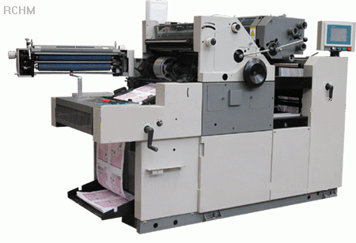



Rs.10 lakh
Equity: Shareholders
Proprietors
Creditors
20%
80%
5 lakh
1 lakh
4 lakh

Slide 2
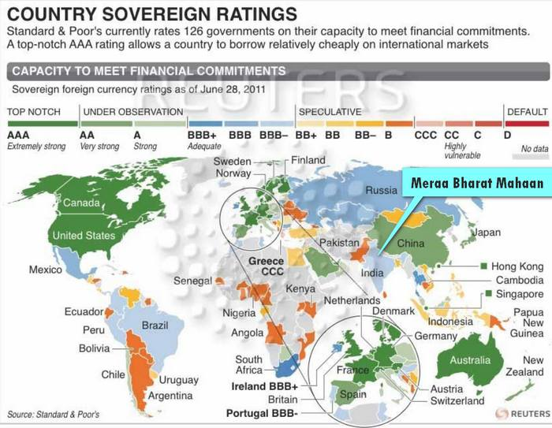
Gilt Edged
Junk

Slide 3
Municipal bonds
OFCD and other types of debenture
Nominal – inflation = Real interest

Slide 4
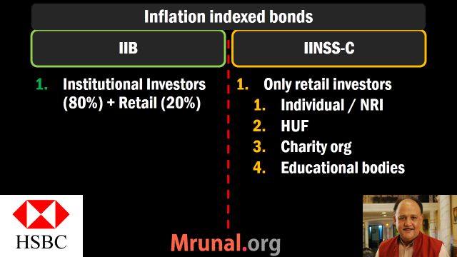

Slide 5
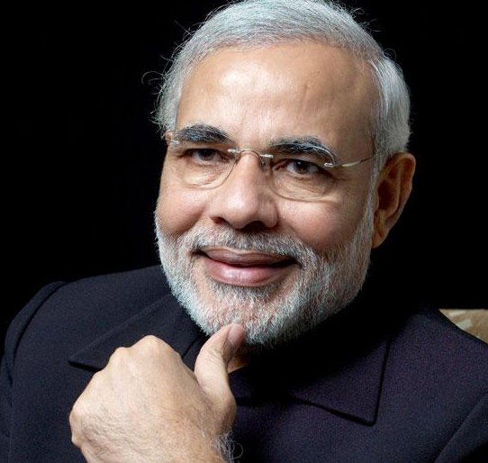
Financial Market
Money Market
Capital Market
Primary
Secondary
Short term
Long term
T-Bill
G-Sec

Slide 6
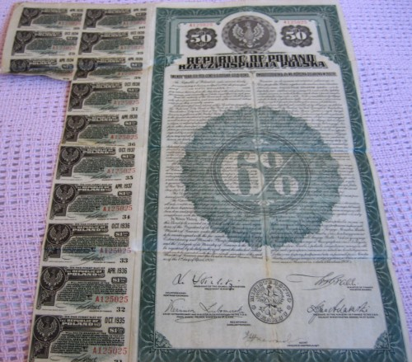
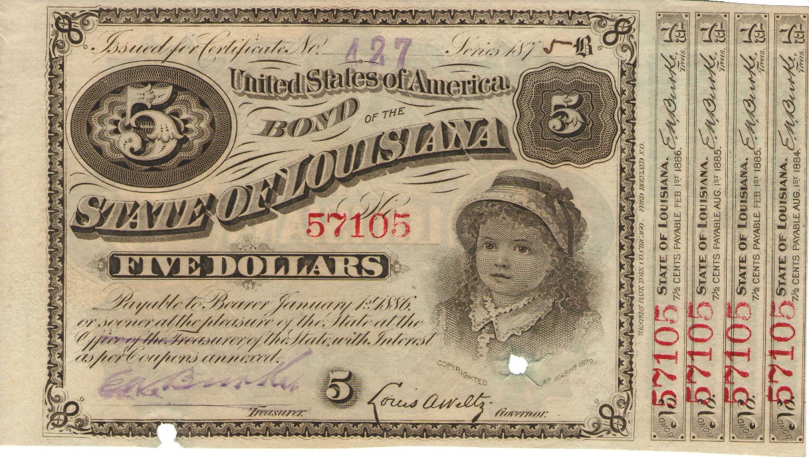
Coupon Bonds
Bearer Bonds

Slide 7
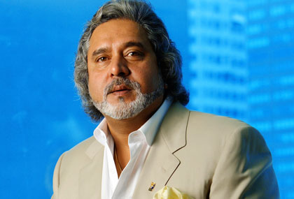





Underwriter
Promoter
Public issue
Fixed Price
Book building
E-IPO
Bonus, rights, preferential
Notes:
Red Herring: Offer price & date not given
US: Investment banker
UK: Merchant Banker

Slide 8
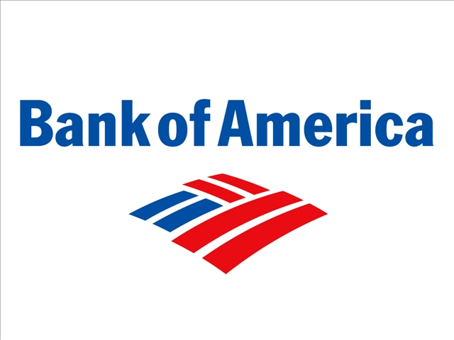

Shares
ADR
Dividend
$$
NASDAQ

Slide 9



Mutual fund
NAV
Unit
Unit
Unit
EXIT LOAD
Portfolio (AMC)
Notes:
NAV fluctuates daily.
Definition: Mutual funds companies collect an amount from investors when they join or leave a scheme. This fee charged is generally referred to as a 'load'. Exit load is a fee or an amount charged from an investor for exiting or leaving a scheme or the company as an investor. Description: The aim behind the collection of this commission at the time investors exit the scheme is to discourage them from doing so, i.e. to reduce the number of withdrawals by the investors from the schemes of mutual funds. Different mutual funds houses charge different fees as an exit load.

Slide 10
ETF: Exchange Traded Fund
ONGC, CIL, GAIL
10 CPSE
Rs.3000 crore
NFO
Rs.10
Rs.10
Rs.20
Rs.10
Portfolio Goldman Sach
BSE-NSE
Notes:
NAV fluctuates daily

Slide 11



Hedge Fund = pvt MF for HNI
Unit
Unit
Portfolio (Hedge Fund)
Unit
Notes:
NAV fluctuates daily

Slide 12








Hawala operator sends Rupees to Tax Haven, converting
to Dollars
Sadhu Yadav a.k.a Politician, builder, Contractor & Mafia
all in one Multiskill
Hedge Fund Manager or Investment banker
in Tax Haven
SEBI registered FII
P-Note
Derives value from FII’s portfolio
FII’s portfolio

Slide 13




How to memorize?
PUT option:
Right to sell
But no obligation to sell

Slide 14
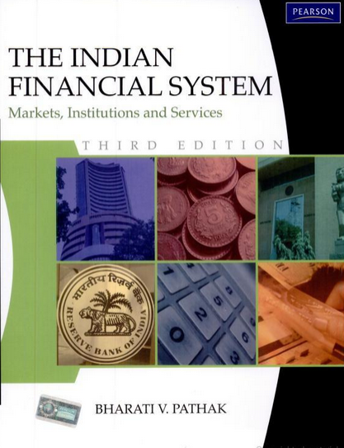
Share Market
Sensex calculation
Stag, Bulls and bears
Harshad Mehta, Ketan Parekh, Circuit Breaker
Dematerialization, PAN card
If any discrepancy in these PPTs vs. wiki,Ramesh, Dutt-Sundaram et al that’s bcoz I refer to book for NBFC & Finance topics.
PS: You don’t need to buy or read this book. This is only for ‘disclaimer’.

Slide 15

SENSEX calculation: 1979
70k with public
30k with Mallya

Slide 16
1979
Free float Market cap (FFMC)
=Price of each share x total # of shares with public.
=10 x 70,000
=7,00,000 Rs. (1st April 1979)

Slide 17
Financial Market
Money Market
Capital Market
Primary
Secondary
Short term
Long term
STAG
Male deer
FRESH
Resold

Slide 18

Types of investors
Bull
Bear
Hopes that prices will rise,
Hence purchases.
Fears that prices will fall,
Hence sells.

Slide 19
2015
Free float Market cap (FFMC)
=Price of each share x total # of shares with public.
=2000 x 70,000
=14 crore. (2015)

Slide 20
BSE-SENSEX Formula
(FFMC @Present / @base year) x 100
(@2015 /@1979) x 100
(14 Crore/ 7 lakh) x 100
20,000 = SENSEX
In real SENSEX: weighed average of FFMC of 30 companies.
Weights assigned as per size of company
Base market cap. Adjustment formula (INDEX Cell) –weighted average.
Notes:
S&P 500

Slide 21
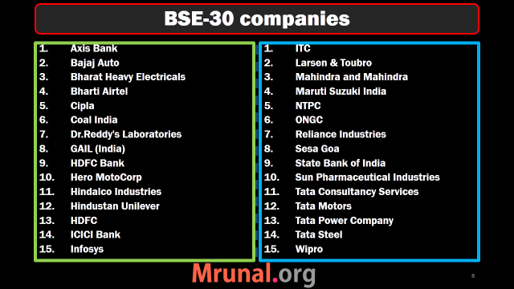

Slide 22
BSE-SENSEX Formula
Sensex =Sensitive + Index.
World’s Oldest: Amsterdam Stock exchange (1602) Netherlands
ASIA oldest: Bombay Stock Exchange (1875)
Chronology India: BSE-A’bad-Kolkata-NSE

Slide 23
Share market goes DOWN when?
Down: War, Inflation, political instability
UP: soft monetary policy, relaxing FDI norms, M&A rumors

Slide 24
Problems with Paper shares?
delivery problem.
Fear of theft.
Transfer delay
Solution:
Dematerialization (mid-90s)

Slide 25
Demat System
Your DEMAT account
Your Paper Shares
Depository
CSDL
NSDL
Dep.
Participant
SBI
HDFC
ICICI
Customer
You
Financial inclusion
#PAN
#DEMAT
Notes:
Securities depository ltd.

Slide 26
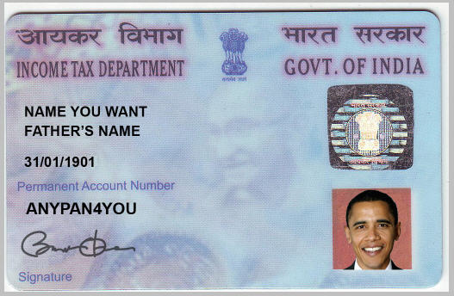
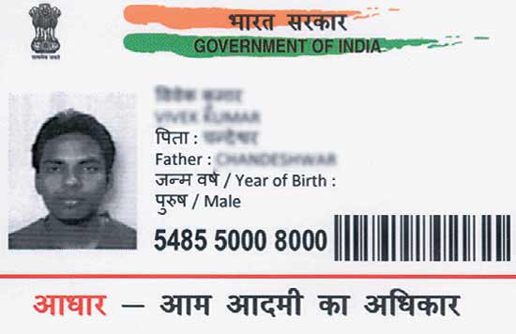
PAN card
UID number
PAN: 10 digit alphanumeric number
By Income Tax department
12 digit unique number
By Unique Identification Authority of India (UIDAI)

Slide 27
PAN card
UID number
All residents and NRIs
Doesn’t change with address
Same.

Slide 28
PAN card
UID number
No minimum / maximum age limit.
No biometric data except photo.
~Rs100 fees
Eye, photo, finger-print
Less 3 years=> biometric info…X
No fees.

Slide 29
PAN card
UID number
individual, firm, joint venture
Only individual

Slide 30
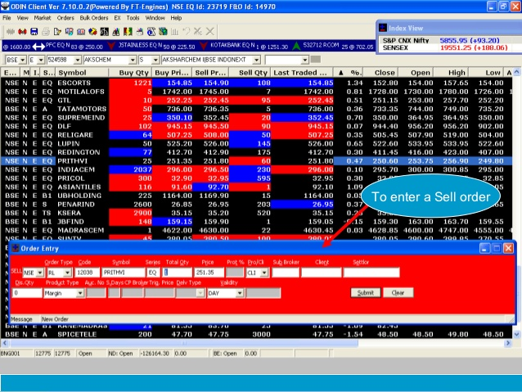
Online Trading
BOLT: BSE’s online trading system
NEAT: NSE for automated trading
VSAT (Very Small Aperture Terminal)
Notes:
March and September
Very Small Aperture Terminal
45 minutes

Slide 31
Online trading stops during..
Solar flare: high energy particles, electromagnetic radiation- they disrupt satellite communication
Equinox:

Slide 32
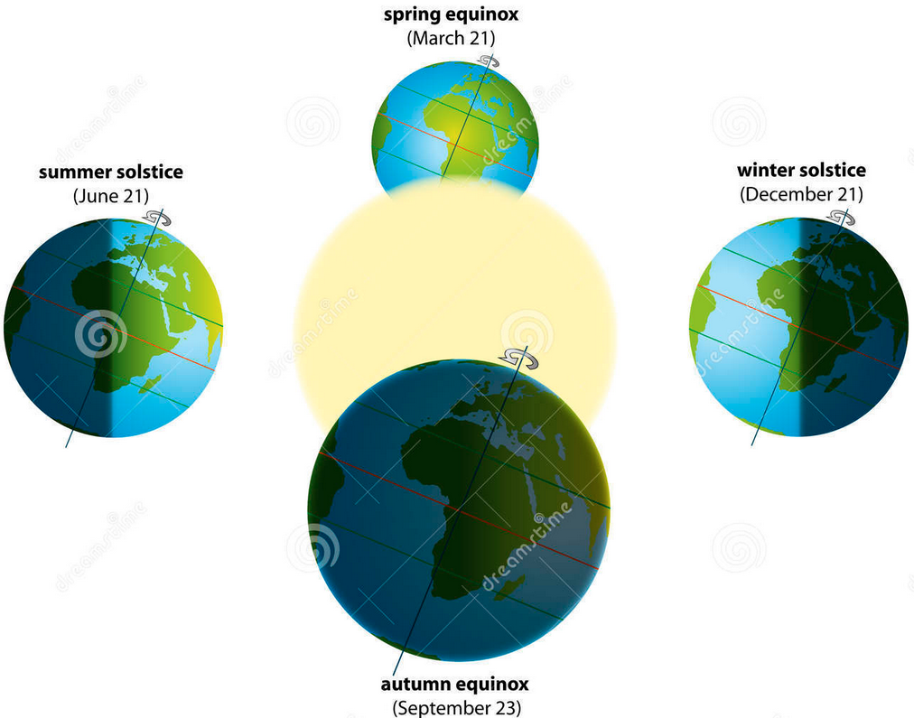

Slide 33

VSAT= Geostationary satellite

Slide 34
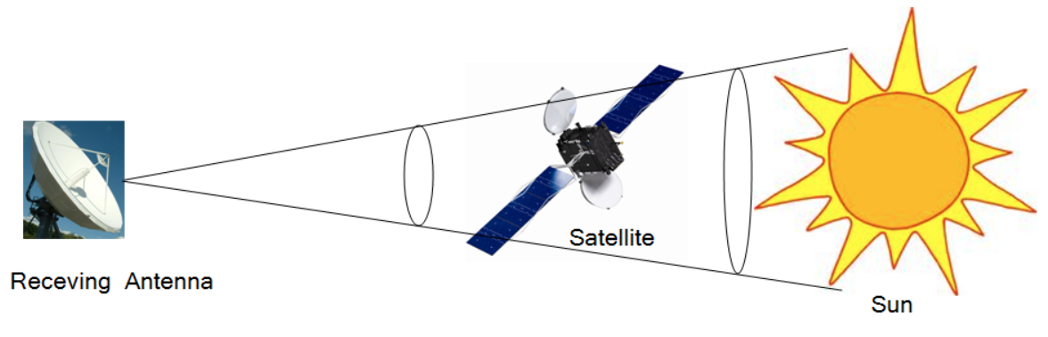
During Equinox

Slide 35
SENSEX calculation
DEMAT system
PAN vs Adhar
Online trading

Slide 36
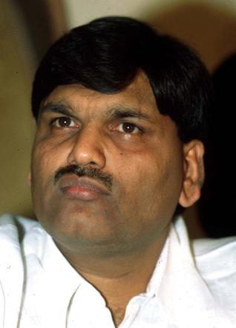
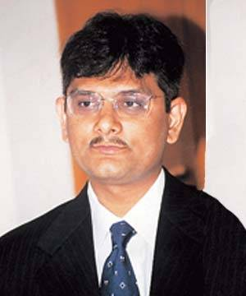
Harshad Mehta Ketan Parekh
Arrange Free money
Use it to manipulate share prices

Slide 37
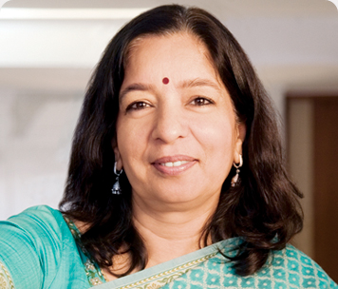
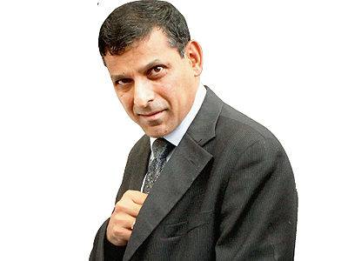

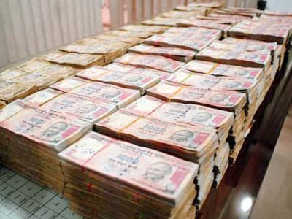
Repo Rate
Purchase
@100 Cr.
Needs R$
Re purchase
@108 Cr.
Notes:
Arundhati Bhattacharya

Slide 38
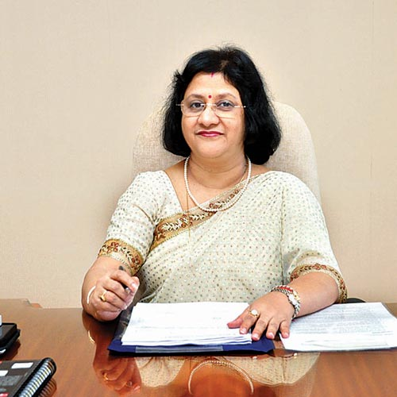
Ready Forward deal
Purchase
@100 Cr.
Needs R$
Re purchase
@108 Cr.
Notes:
Arundhati Bhattacharya

Slide 39
Ready forward deal
Needs R$
Bank
Receipt
Bank
Receipt

Slide 40
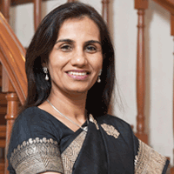
Ready forward deal
Bank
Receipt
Free money

Slide 41
Harshad Mehta
1992
He invests ~1000 Cr.
SENSEX 2000 => 4500 (Jan-April)
ACC Cement: 200 => 9000
CBI arrest
2001: jail heart attack

Slide 42
Ketan Parekh
2001
Global Trust Bank (250 cr)
Madhupura Coop (1,000 Cr)
Visualsoft: 600=> 8,000
SonataSoft: 90=> 2000
Benami subscription
Bear cartel starts selling
2010: SKS Microfin.
ONGC gas pricing
Notes:
Hardly 1 year jail.

Slide 43
Reforms taken
High volatility = genuine investors turned away
Next time, Poor response to new securities
Gold / real estate=>CAD=>Weak rupee =>inflation
Ban on “Badla system”
Circuit breakers

Slide 44
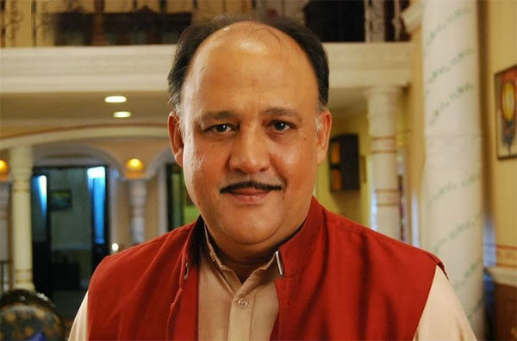
Badla system
Reforms
Carry forward
Bottom line: player bets on borrowed money
Trade settled in T+5, 10, even 72 days. He only needs to pay interest to broker during that time.
SEBI banned: only T+2 system.

Slide 45
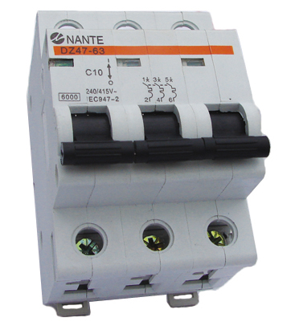
Circuit Breaker
Share prices
Two types
Individual share: BSE/NSE
Market wide: SEBI

Slide 46
Market wide Circuit Breaker
MWCB
Benchmark: Previous day (SENSEX, NIFTY)
1st Jan : SENSEX 10000
10%: 1000 up OR down: 1 hr halt
15%: 2 hr halt
20%: entire day
All stock exchanges
India: two way circuit breaker
Developed countries: one way (bullish)

Slide 47
SENSEX calculation
DEMAT system
PAN vs Adhar
Online trading
Harshad Mehta, Ketan Parekh
Circuit Breaker system

Slide 48
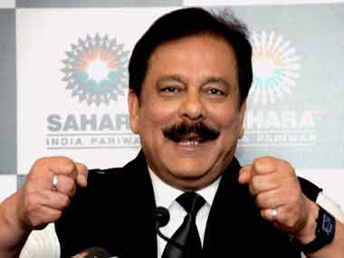
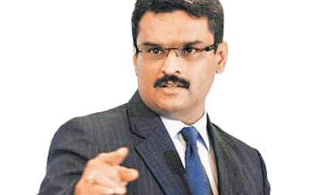
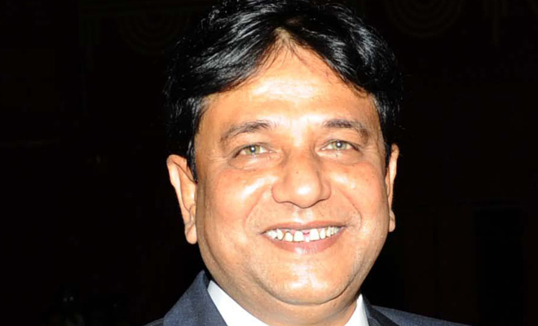
Sahara
NSEL
Saradha
Financial Scams in Recent years
Modus Operandi Ph.D …Only Basic idea
How to prevent….Important

Slide 49
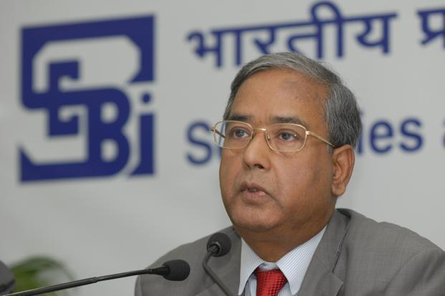

SEBI Sahara OFCD

Slide 50
Types of companies
Companies Act
2013
Public Ltd.
7-unlimited
Listed
Vodafone India.
Unlisted
Nokia-Microsoft
One person
Private ltd.
2-200

Slide 51
2008-11: Game begins
SAHARA
Sahara Housing Investment Corporation (unlisted)
Sahara India Real Estate Corporation (unlisted)
Issue OFCD – for more than TWO Years (3-10 days)
>2 crore people (50 people)
>24,000 crores
Notes:
23 million people : mostly from small town and villages
Even biggest IPO coal India 15k cr

Slide 52
SEBI argues
SAHARA defends
SEBI act: All CIS, Except
Nidhi
Chit Funds
Co-operatives
Ours Unlisted companies
Under Corp. Affairs
SEBI= only listed Co.
Need time to Refund
Notes:
SEBI: UK Singha
Nidhi (Dept.Corp)
Chit Funds (State Registrar + RBI)
Co-operatives (State Registrar)

Slide 53
SEBI order 2011
Sahara Scam
Stop OFCD
Refund $$ + 15% interest
Give proof of Refund
Untraceable Account=>Govt. gets money

Slide 54
Sahara appeals further
Sahara Scam
SAT: Upheld SEBI order (2011)
SC: upheld SEBI order (2012)

Slide 55
Refund not done
Sahara Scam
Yet to refund entire amount
Not given proof of all refunds
2014, Feb: SC Contempt- Subrato Roy Arrested.
2015, Jan: SC allowed group to raise overseas-loan for Rs.10,000 crore as bail

Slide 56
A Brief History
SEBI
1992: Securities and Exchange board of India (Statutory Body)
1999: Amendment- CIS brought under SEBI. (Except Nidhi, Chit fund and cooperatives)
2002: powers of search and seizure.
Boss: U.K.Sinha

Slide 57
SEBI Ordinance
Sahara Case dragged due to jurisdictional disputes.
Fund gathered >100 Cr. = under SEBI. 50 investors, CIS
Raid, attach
Arrest for non-compliance
Fast track court, info.-exchange with foreign agencies.

Slide 58
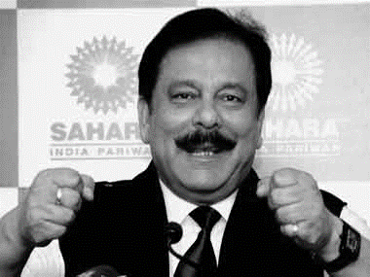
Sahara
OFCD w/o permission
SEBI ordinance
NSEL
Saradha
Major Financial Scams
Modus Operandi Ph.D …Only Basic idea
Larger picture and How to prevent….Important

Slide 59



NSEL Crisis
What is commodity trading?
Why NSEL Crisis?
Steps taken?

Slide 60
Commodity Market
METAL: Aluminum, gold, silver
AGRI: castor seeds, cotton, wheat, basmati
ENERGY: Oil, coal
Notes:
Since NSEL crisis related to Agri. trading

Slide 61

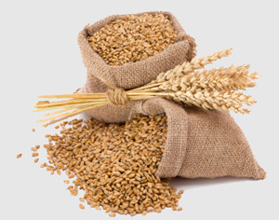


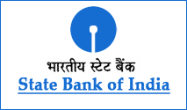
2 Month Rent: Rs. 200
LOAN

Slide 62



T+2 = Rs. 1000/Qt.
T+10 = Rs. 1800/Qt.
NSEL warehouse
2 Month Rent:
Rs. 200
Warehouse
receipt
T+2
T+10
Rs.1000
Rs.1800
Farmer
Mrunal
Jethalal

Slide 63
T+2 = Rs. 1000/Qt.
T+20 = Rs. 1800/Qt.
2008:
Govt. Permitted
T+20 ; T+30
Broker
Brokerage
Profit
Investors
Notes:
Inflation

Slide 64
NSEL: E-series
Dematerialized form, Online trading
NSEL promoter Jignesh Shah (FTIL)- Fake warehouse receipts
NSEL commission: 2,000 Cr (2009) => 3 lakh Cr. (2013)

Slide 65
July 2013
FMC
T+10
Inflation, irregularity
Broker
Brokerage
Profit
Investors
Notes:
Entry of MCX
, NSEL was offering contracts over T+10 settlement cycle. It allowed buyers who could not pay for commodities they bought more time and sellers who could not deliver commodities sold on time.

Slide 66
Crisis beings: July 2013
FMC orders T+10
NSEL directed all brokers / investors to settle T+10
Brokers: Motilal Oswal, India Infoline => Rs 700 crore.
>Rs.5000 crore contracts
>15000 Investors
Notes:
5600

Slide 67
Crisis : August 2013
NSEL
NSEL: weekly settlement of dues
Will auction from warehouses
Weekly Rs.100 Cr. (Auction)
Total 5600 Cr.
Not enough stock, fake receipt

Slide 68
Steps Taken
NSEL
NSEL CEO Anjani Sinha arrested
FTIL Jignesh Shah arrested.
Government banned E-series system
Arvind Mayaram Panel (PM)
IT Dept. => NSEL allied companies
Notes:
(Economic Affairs Secretary)

Slide 69
Steps Taken
NSEL
FMC investigation
FMC (Consumer Affairs)=> Finance Ministry
Companies Act: FTIL to be merged with NSEL. (But Bombay HC stayed)
2015, Jan: Economic Offenses Wing (EOW) and ED attached NSEL assets
Liquidation => investors money refund.
FTIL’s commodity trading software “Odin”
Notes:
(Economic Affairs Secretary)

Slide 70
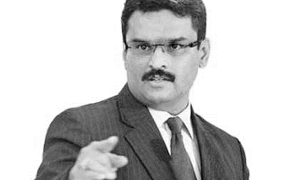
Sahara
NSEL
Saradha
Major Financial Scams
Modus Operandi Ph.D …Only Basic idea
Larger picture and How to prevent….Important

Slide 71
Saradha Chit Fund
How does Chit fund work?
What is Saradha Scam?

Slide 72
Monthly contribution x 3 months
10,000
10,000
Commission
1,000
Total 30,000
10,000
Total 29,000 Remain

Slide 73
Lowest Demand (Bidder) gets loan
29,000
28,000
Total 29,000
25,000

Slide 74
Lowest Demand (Bidder) gets loan
Total 29,000
25,000
Rs.4000: equally distribute among members

Slide 75
Month 1 Alok Borrowed Rs.25,000
Chit Fund
Game: give 10,000 x 3 months
Month#1: 10,000
Month#2: 10,000
Month#3: 10,000
Total returned= Rs.30,000
Loan = Principal + Interest paid
Loan = 25,000+ 5,000 = 30,000

Slide 76
Jurisdiction?
Chit fund
Chit fund = Contract (SC order)
Contract = Concurrent list
Both union and state can enact laws.
UNION: Prize Chits and Money Circulation Schemes 1978
States: empowered under Chit Funds Act 1982
States: Kerala, TN, Andhra, W.Bengal

Slide 77
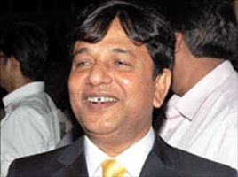
Saradha Scam
Chit Fund
Sarada Devi: Wife Ramkrishan Paramhan
CMD Sudipta Sen (2006)
Saradha group: 280 companies
Each running separate scheme
None registered as “Chit fund”
Over 3 lakh agents employed.

Slide 78
Saradha Scam
Chit Fund
Contribute even Rs.100/-
15-50% return offered
Free bicycles, TV, fridges, paid-vacactions
Roped in TMC leaders, Celebrities
2008-09 Subprime crisis, sharemarket down, investors fooled
Rs.4000 crores collected

Slide 79
Saradha Scam
Chit Fund
Schemes labeled as “Chit funds” but Money siphoned off given to Hotels, travel, media, real-estate companies
=Collective investment Scheme (CIS)
If >50 people => SEBI permission required. [After 2014 ordinance, all types of CIS included]
Overlapping jurisdiction = dodged SEBI bullet.

Slide 80
Saradha Scam
Chit Fund
Not generating surplus, couldn’t return deposits on maturity, unviable business plans.
SEBI, SFIO, ED begins inquiry
TMC MP Kunal Ghosh, TMC Minister Madan Mitra etc. arrested

Slide 81
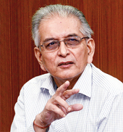
Saradha Scam
Chit Fund
W.Bengal Government: Justice Shyamal Sen commission to probe the scam, repay money to investors.
17 lakh complaints received, hardly 20% compensated.
Later shut down (October 2014)

Slide 82
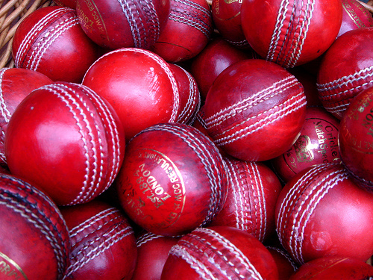
Investigation
Chit Fund
2013: SFIO recommends CBI investigation
2014, May: SC hands over case to CBI
2015, Jan: Rumor-mill about TMC leader Mukul Roy
2015, Jan: Justice RK Patra dead- he was inquiring Odisha Chit fund scam.
2015, Feb: Home Secretary Anil Goswami removed for interfering in probe
Notes:
ED: Prevention of Money Laundering Act (PMLA) in the Saradha ponzi case probe

Slide 83
OFCD without SEBI approval
NSEL fake
warehouse receipts
Puppet Cos.
Non-chit fund
SEBI ordinance
FMC =>FM
Prize Chits and Money Circulation Scheme
Piecemeal, Firefighting

Slide 84
Delays
Banking | Finance(SEBI) | Insurance(IRDA) | NPS
In house | SCORES | Inhouse | NSDL
B.Om | SEBI | I.Om | PFRDA
Consumer court | SAT | Consumer court | Consumer Court
Court | Supreme court | Court | Court
Notes:
(SEBI complaints redress system) webportal
Securities Appellate Tribunal (SAT)
IDRA Grievances cell | Insurance ombudsman

Slide 85
Lack of coordination
6 primary regulators
RBI, SEBI, IRDA, PFRDA, EPFO, and FMC
NABARD, SIDBI, NHB are also involved in regulation
6 Central ministries + State Govt.
Consumer courts also involved.
Lack of coordination, loopholes

Slide 86
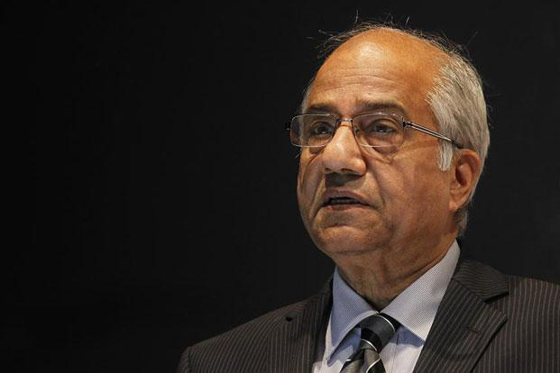
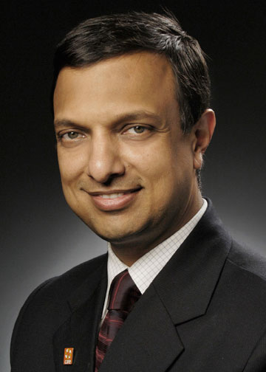
Regulatory Reforms: Committees
FSLRC (FinMin) 11-13
Nachiket Mor (RBI) 13-14

Slide 87
Non Legislative
Legislative
Financial sector
legislative reform commission (FSLRC)
Justice BN Sri Krishna

Slide 88
Non-Legislative
Legislative
Public consultation
Consumer awareness
Transparency
Repealing laws, to create IFC
Merging existing bodies
Creating new bodies

Slide 89

year | Act
1934 | Reserve Bank of India Act
1938 | Insurance Act
1944 | Public Debt Act
1949 | Banking Regulation Act
1952 | Forward Contracts (Regulation) Act
1956 | Securities Contracts (Regulation) Act
1961 | Deposit Insurance and Credit Guarantee Corporation Act
1970 | Banking Companies (Acquisition and Transfer of Undertakings) Act
1992 | SEBI
1996 | Depositories Act
1999 | FEMA Act
1999 | IRDA Act
2006 | Government Securities Act
2013 | PFRDA Act
Indian Financial Code

Slide 90
Indian Financial Code
single, unified financial law
precise objectives
precise powers given to financial agencies
checks and balances around regulators
450 clauses and six schedules.

Slide 91

FSLRC: Present vs Future Agencies
RBI
RBI
Debt Mgmt
SEBI
FMC
IRDA
PFRDA
UFA
FSAT
FRA
SAT
Resolution Corp (DICGC)
Financial Data Management Centre
FSDC
Notes:
United financial agency (UFA)
Financial Redressal Agency (FRA)
B. N. Srikrishna (2008-2013)
FinMin (2011-13)
resolution corporation would charge a fee to all firms based on the probability of failure.

Slide 92
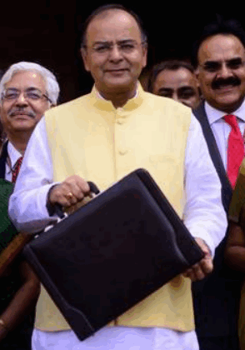
Financial Stability and Development Council (FSDC)?
2010, Dept of Economic affairs
FM + 5 regulators
RBI, SEBI, IRDA, PFRDA and FMC
Coordination, consultation, literacy

Slide 93
Financial stability board FSB, ‘09
Under G20,
Basel, Switzerland
Coordination between national bodies
Meets twice a year
India is member of FSB

Slide 94
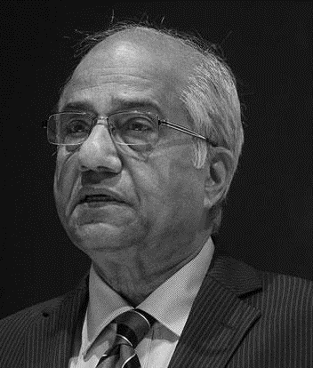
Regulatory Reforms: Committees
FSLRC (FinMin) 11-13
Nachiket Mor (RBI) 13-14

Slide 95
Nachiket Mor (RBI Panel, 2013-14)
reforms
Financial Redress Agency (FRA)
For all six regulator RBI, SEBI, IRDA, PFRDA, EPFO, and FMC
FRA: not an individual
Board of directors
Powers of Consumer courts
Similar body @State level:
MFI-NGO, Chit-fund, Local moneylender.

Slide 96
Banking ombudsman
Customer complaints against bank
From UK => India 1995
RBI’s general managers => 3 years => No reappointment
Except J&K

Slide 97
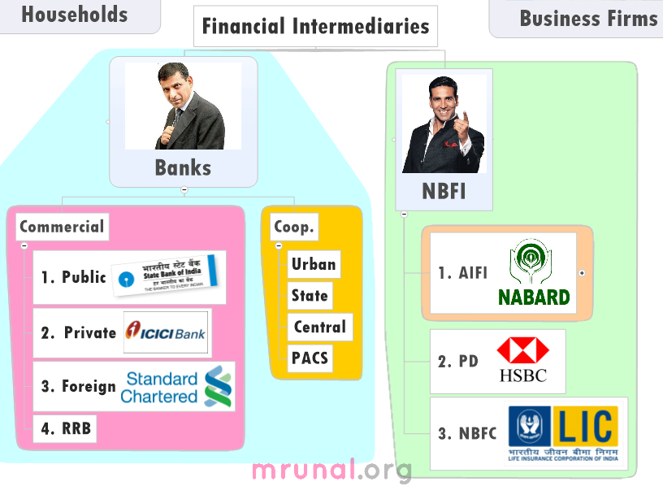
Jurisdiction of BO?
All banks
Only matters upto Rs.10 lakh
A’bad BO
Guj + Diu, Daman, Haveli (Bombay)
Loan giving

